Slide 1

Hadoop Project
Samaresh Kumar Pradhan
November 13, 2018
@Copyright 2018 reserved for intellipat.com

Slide 2
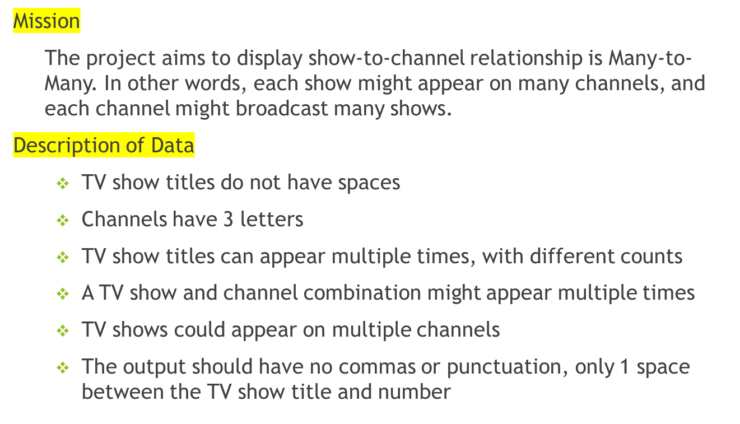
Online TV Show Data Analysis
@Copyright 2018 reserved for intellipat.com

Slide 3
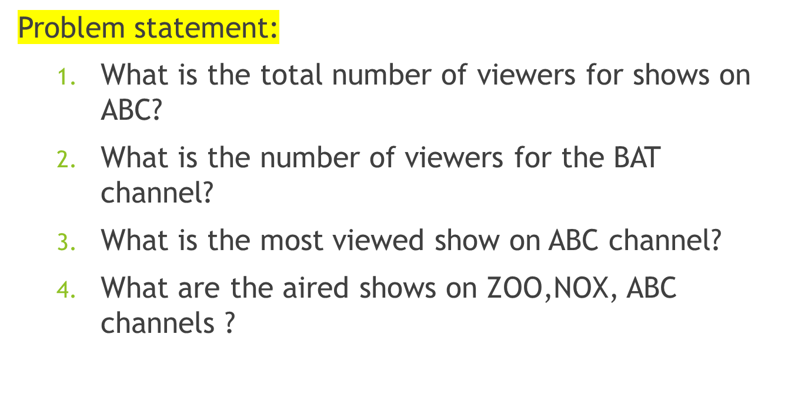
Online TV Show Data Analysis
@Copyright 2018 reserved for intellipat.com

Slide 4

Online TV Show Data Analysis
@Copyright 2018 reserved for intellipat.com

Slide 5
Solution Statement
Step 1 – Software Installation and Configuration
  Install Hadoop, JDK and Hive on Linux machine
  Set the class path inside .bash_profile file
  Start Hadoop
  Set the Safe Mode to False
    sudo -u hdfs hdfs dfsadmin -safemode leave
  Start Hive
  Create a DB and Use it
    Create database channeldb;
    Use channeldb;
@Copyright 2018 reserved for intellipat.com

Slide 6
Solution Statement
Table Creation
  Create two table as below –
    CREATE TABLE IF NOT EXISTS channelinfo ( program String, channel String)
    COMMENT 'TV Channel details'
    ROW FORMAT DELIMITED
    FIELDS TERMINATED BY ','
    LINES TERMINATED BY '\n'
    STORED AS TEXTFILE;
    CREATE TABLE IF NOT EXISTS programinfo ( program String, viewers Int)
    COMMENT 'TV Channel Viewers details'
    ROW FORMAT DELIMITED
    FIELDS TERMINATED BY ','
    LINES TERMINATED BY '\n'
    STORED AS TEXTFILE;
@Copyright 2018 reserved for intellipat.com

Slide 7
Solution Statement
Step 3 – Data Upload to the Table as below
Upload the attached data to the linux machine on the below path :
/home/training/hive_training/project_data
Upload the data to the Hive Table using the below command
LOAD DATA LOCAL INPATH '/home/training/hive_training/project_data/join2_genchanA.txt’
INTO TABLE channelinfo;
LOAD DATA LOCAL INPATH '/home/training/hive_training/project_data/join2_genchanB.txt’
INTO TABLE channelinfo;
LOAD DATA LOCAL INPATH '/home/training/hive_training/project_data/join2_genchanC.txt’
INTO TABLE channelinfo;
LOAD DATA LOCAL INPATH '/home/training/hive_training/project_data/join2_gennumA.txt’
INTO TABLE programinfo;
LOAD DATA LOCAL INPATH '/home/training/hive_training/project_data/join2_gennumB.txt’
INTO TABLE programinfo;
LOAD DATA LOCAL INPATH '/home/training/hive_training/project_data/join2_gennumC.txt’
INTO TABLE programinfo;
@Copyright 2018 reserved for intellipat.com

Slide 8
Solution Statement
Question - What is the total number of viewers for shows on ABC?
Answer -
1115974
Solution -
  select sum(pi.viewers) toatl_viewers
  from channelinfo ci join programinfo pi
  on ci.program = pi.program
  where ci.channel ='ABC';
@Copyright 2018 reserved for intellipat.com

Slide 9
Solution Statement
Question - What is the total number of viewers for Shows on BAT?
Answer -
5099141
Solution -
  select sum(pi.viewers) toatl_viewers
  from channelinfo ci join programinfo pi
  on ci.program = pi.program
  where ci.channel =‘BAT';
@Copyright 2018 reserved for intellipat.com

Slide 10
Solution Statement
Question - What is the number of viewers for the BAT channel?
Answer –
  Almost_Cooking 49501
  Almost_Games 49237
  Almost_News 93184
  Almost_Show 50202
  Almost_Sports 98614
  Almost_Talking 202854
Like this, it will show all shows and their viewers on Channel BAT
Solution -
  select ci.program, sum(pi.viewers) viewers
  from channelinfo ci join programinfo pi
  on ci.program = pi.program
  where ci.channel = 'BAT'
  group by ci.program;
@Copyright 2018 reserved for intellipat.com

Slide 11
Solution Statement
Question - What is the most viewed show on ABC channel?
Answer –
Hourly_Talking 108163
Solution -
  select ci.program, sum(pi.viewers) as viewers
  from channelinfo ci join programinfo pi
  on ci.program = pi.program
  where ci.channel = 'ABC'
  group by ci.program
  order by viewers desc
  limit 1;
@Copyright 2018 reserved for intellipat.com

Slide 12
Solution Statement
Question - What are the aired shows on ZOO,NOX, ABC channels ?
Answer -
NOX Surreal_Talking 218716
ABC Hourly_Talking 108163
Solution –
Contd…
@Copyright 2018 reserved for intellipat.com

Slide 13
Solution Statement
select u.channel, u.program, u.viewers from(
select ci.channel, ci.program, sum(pi.viewers) viewers
from channelinfo ci join programinfo pi
on ci.program = pi.program
where ci.channel ='ZOO'
group by ci.channel, ci.program
order by viewers desc limit 1
union all
select ci.channel, ci.program, sum(pi.viewers) viewers
from channelinfo ci join programinfo pi
on ci.program = pi.program
where ci.channel ='NOX'
group by ci.channel, ci.program
order by viewers desc limit 1
union all
@Copyright 2018 reserved for intellipat.com

Slide 14
Solution Statement
select ci.channel, ci.program, sum(pi.viewers) viewers
from channelinfo ci join programinfo pi
on ci.program = pi.program
where ci.channel ='ABC'
group by ci.channel, ci.program
order by viewers desc
limit 1
) u;
@Copyright 2018 reserved for intellipat.com

Slide 15
Solution Statement
Question –
Considering all the Shows shown on ABC, which is the show that is telecast the most number of times across all channels?
Answer –
Hourly_Talking 19
Solution –
    select ci.program program, count(*) count
    from channelinfo ci inner join (select distinct program from channelinfo where channel = 'ABC') a
    on ci.program = a.program
    group by ci.program
    order by count desc limit 1;
@Copyright 2018 reserved for intellipat.com

Slide 16
Technical Guidance
Technical Trainer
  Raghu Raman
  Sriram Raghavendran
Lab Trainer
  Manish Kumar
  Lav Shulka
@Copyright 2018 reserved for intellipat.com

Slide 17
More Information
More information about the Project
  https://intellipaat.com/
  https://hive.apache.org/
  https://hadoop.apache.org/
@Copyright 2018 reserved for intellipat.com

